Slide 1



App for Mental Support of Type 1 Diabetes
Shira Vahav
Lev Academic Center
Advisor: Dr. Ariella Richardson
Lev Academic Center
Collaborator: Gil Segev BGSegev Labs.
1

Slide 2


Opening
Facial-Recognition Learning system
App for Mental Support of Type 1 Diabetes
Social app of virtual supporting group of diabetes, based on AI
Machine learning system based on data mining for facial spots recognition
2

Slide 3
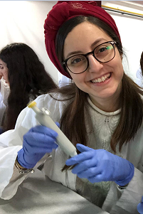
The Motivation
2

Slide 4
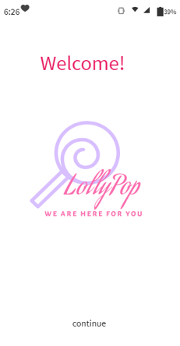

Lollypop- the main of the app
The ultimate goal:
Encouraging the maintenance of a healthy lifestyle for diabetics.
Additional Goals:
Monitoring and control of health indices.
Adequate awareness and tools to cope with the disease.
Raising patient motivation to maintain nutrition and exercise.
3

Slide 5

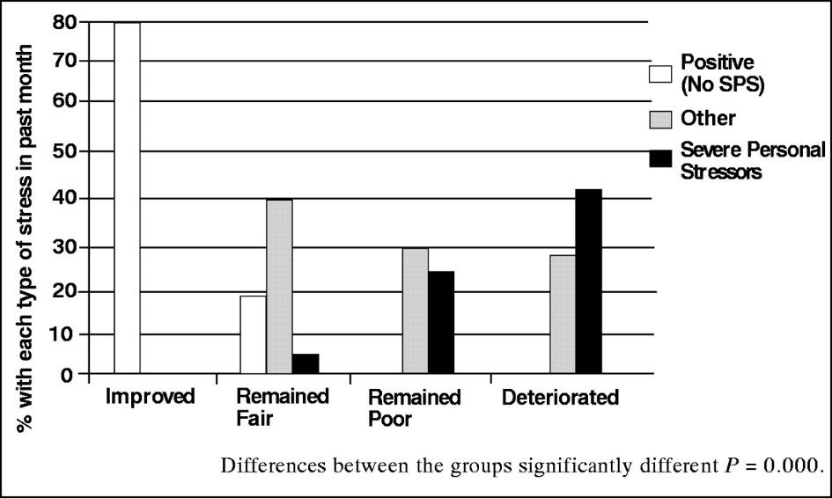
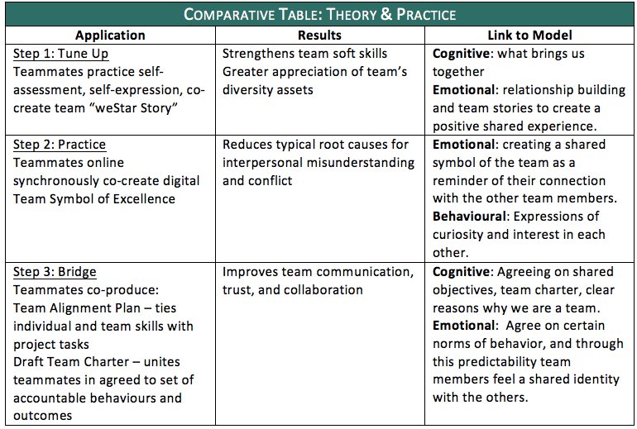
Literature review
Stress is a direct cause of blood glucose imbalance.
Cathy, L. (2005, April 18). Stress and Diabetes: A Review of the Links.
Working on a virtual team raises the group's shared identity and makes it work better.
Theresa, S.H. & Howard, B. E. (2018, July 16). How Effective Virtual Teams Create Shared Identity.
4
Notes:
ההשלכות הקליניות של מחקר זה ממחישות את הצורך בהבנה טובה יותר של השפעות הלחץ, וכן קבלה רצינית של הצורך בתמיכה פסיכו-סוציאלית לאנשים במצוקה זו. האפליקציה שלנו מהווה תמיכה נפשית לחולים שיכולים לקבל סיוע אנושי בכל זמן שירצו. הצורך בתמיכה הנפשית מקילה באופן משמעותי על הלחץ בחייהם ובכך אוטומטית משפרת את אורח חייהם כסוכרתיים. ובכך אפילו משפרת את רמות הגלוקוז בדם שלהם.
תרשים זהות משותפת- עשו case study על צוות שעובד בצורה משותפת ואלו התוצאות.. ראו שהעבודה בצוות וירטואלי יותר טובה
יש צורך בתמיכה פסיכו-סוציאלית לנשים במצווקה נפשית

Slide 6

Market Survey
yes
200 diabetes
100 questions
Sample question:
Would you be interested in participating in a virtual diabetes support group?
no
36%
64%
The conclusion: The future application meets the needs of the diabetics who were asked.
5

Slide 7

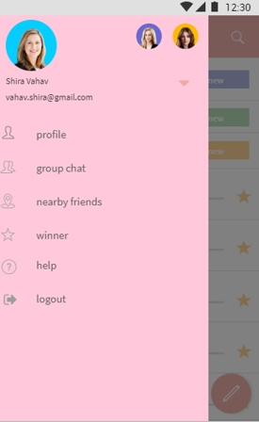
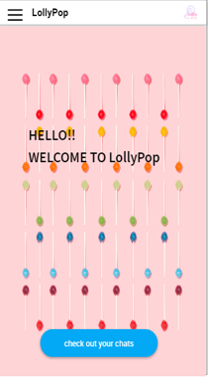
Application characterization
Virtual support groups
Reminders
Lending medical equipment
Monitoring and monitoring other health indicators
Outstanding this month
6

Slide 8


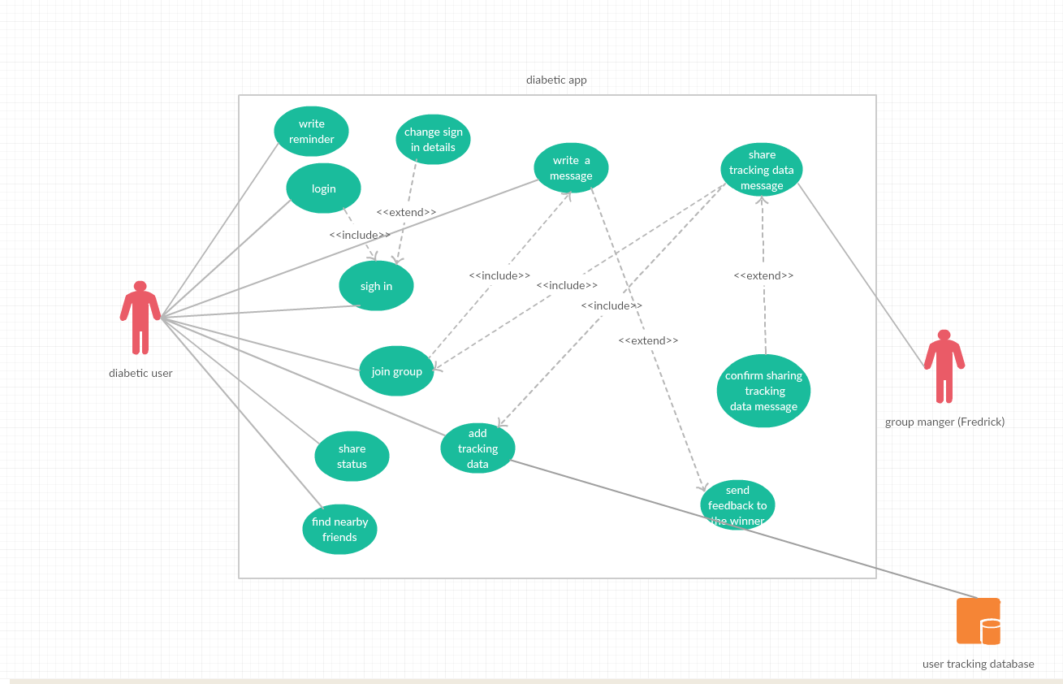
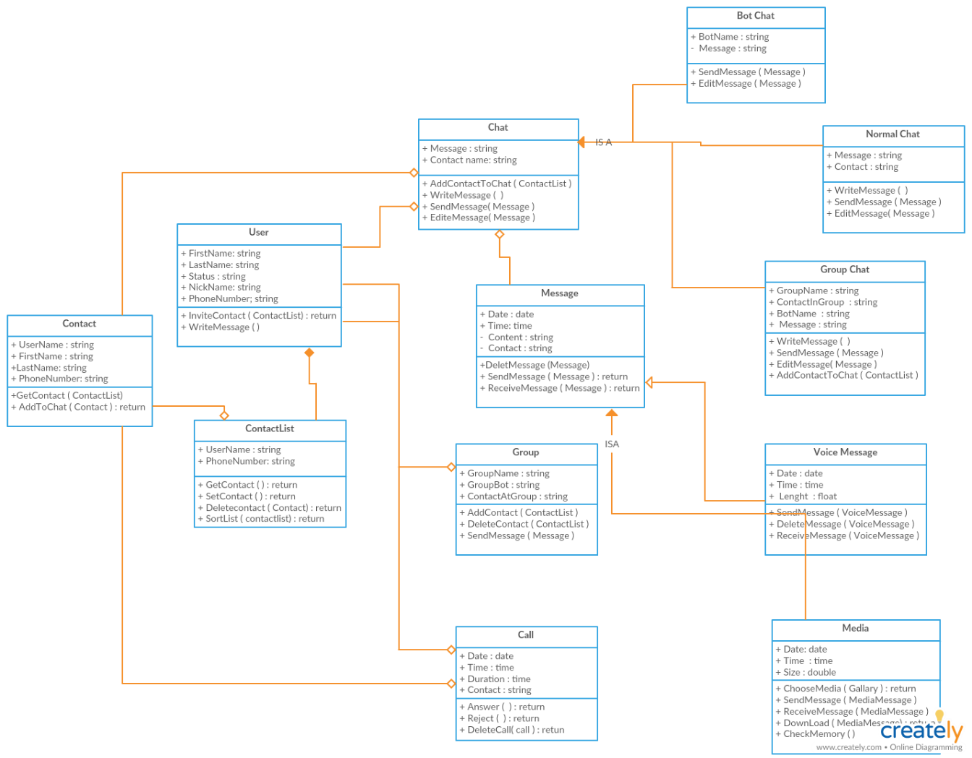
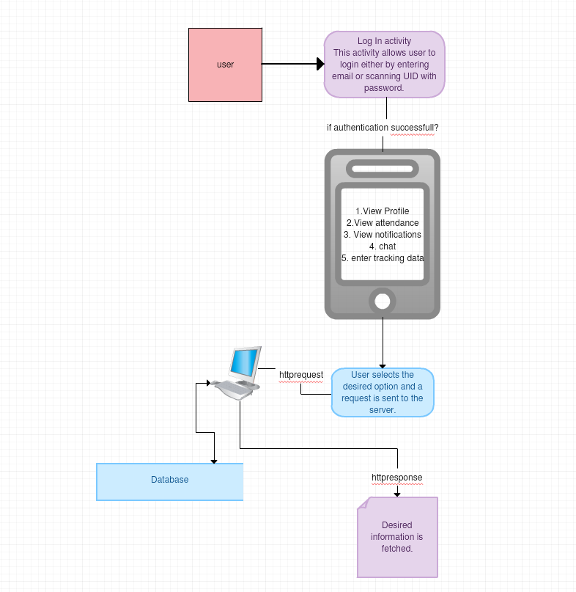
Analysis of the information system
Analysis of the information system
Procedural modeling
Object Oriented Modeling
Build process charts.
Use Case
ITIL Diagram
Class Diagram
7

Slide 9
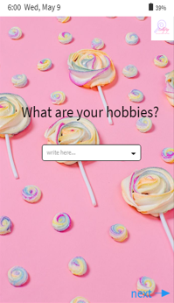
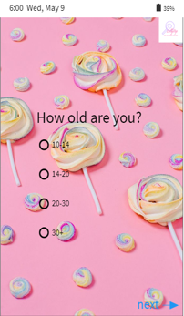
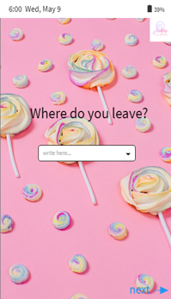

Customized user groups
live?
8

Slide 10
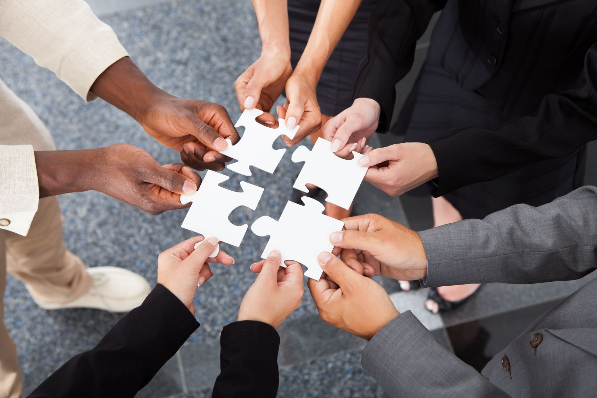
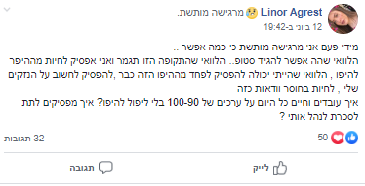
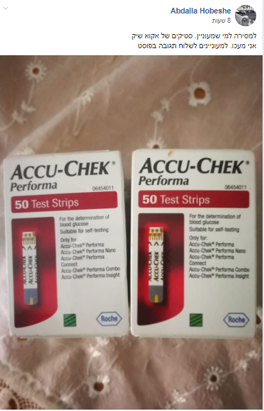
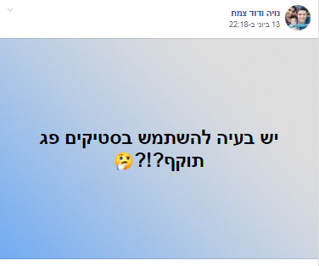
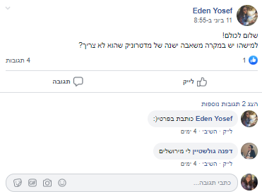
9
Notes:
הנם

Slide 11
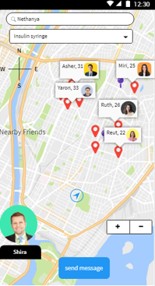
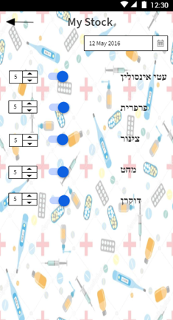
Lending medical equipment from close friends
10
Notes:
הנם

Slide 12
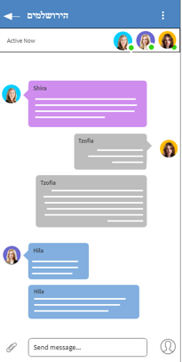
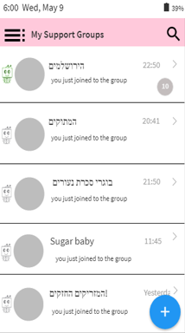
Virtual supporting groups
11
Notes:
הנם

Slide 13
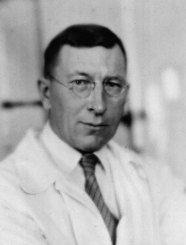
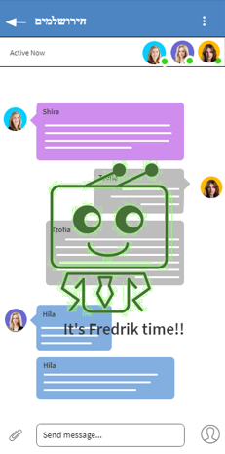
Group Manager - Smart Bot
Who is “Fredrik?”
Frederick Banting was the first to discover insulin.
.
Frederick is:
Smart bot that takes control of the group once a week / day / month
Let everyone share in turn
Intelligent artificial intelligence system. Brain "was built according to data shared by the group
Shares achievements of group members and moves them to the "Outstanding of the Month"

Slide 14
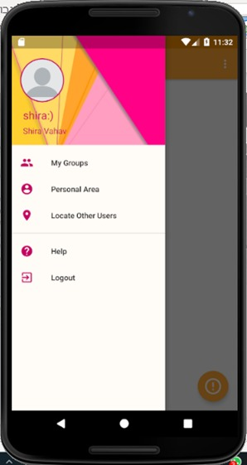
The real app
Collaboration with programmers
The application is built according to the specification document
The app is in development

Slide 15
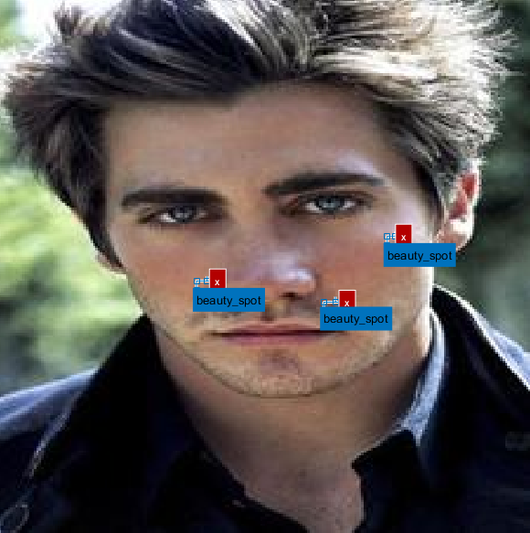
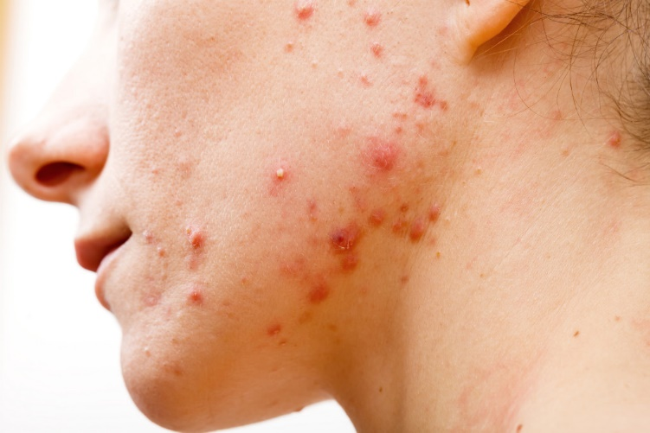

Facial-Recognition Learning system
Using the R-CNN algorithm – neural networks for data mining
Co-authored with Systematics
System run on test set-untagged
images of facial wounds
Building a learning system by using the R-CNN algorithm of neurons for data mining and image processing
System training once by training set
בשיתוף Systematics
Notes:
RCNN https://www.mathworks.com/help/vision/ref/rcnnobjectdetector.html
רשת נוירונים

Slide 16
